Slide 1
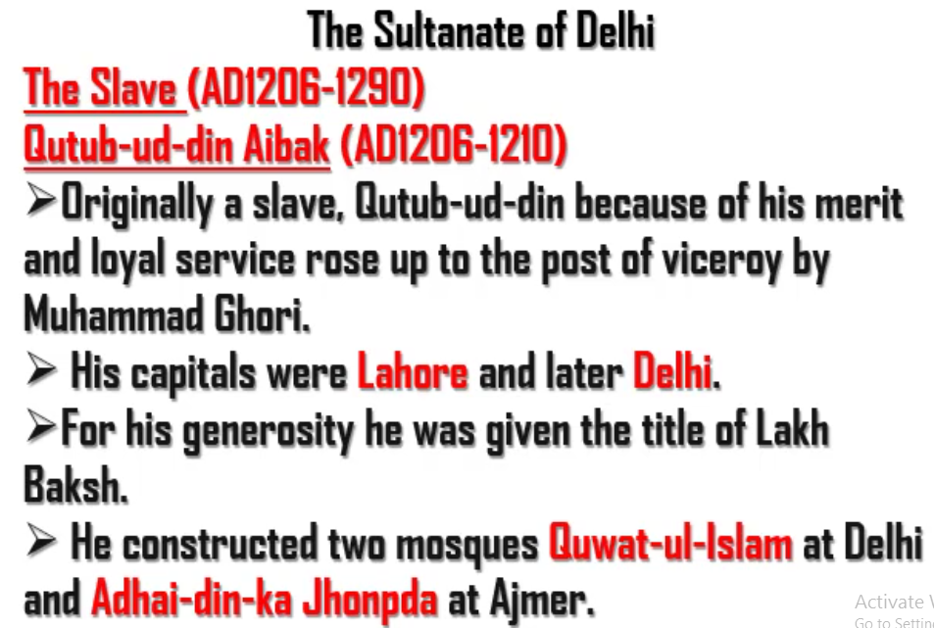
Qutub-ud-din Aibak was a slave to Ghori. He was so loyal that Aibak raised him to the post of Viceroy. After the death of Ghori, he ascended the throne. He came to Delhi by conquering it. As he was a slave to Ghori, the dynasty built by him came to be known as “Slave Dynasty”. The slave in first line should have been “The Slave Dynasty”

Slide 2
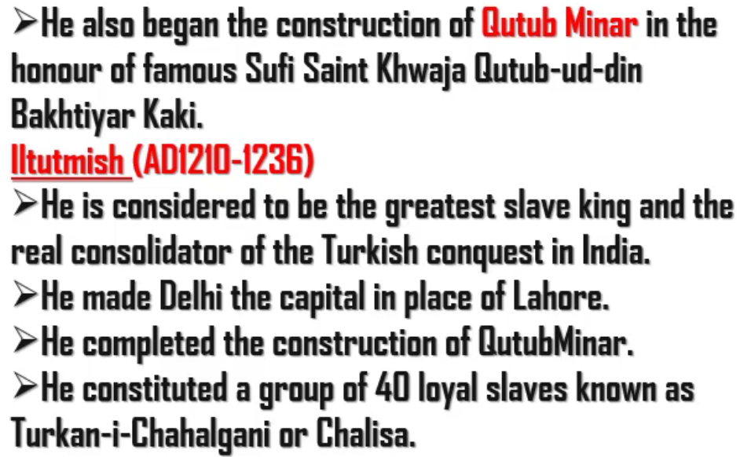
There are five floors in Qutubminar. First floor was built by Qutub-ud-din Aibak. Rest four were built by Iltutmish. But in eaxm if they ask who built Qutubminar, please say Qutub-ud-din Aibak.
Itutmish is also known as Shamsuddin.
Iltutmish constituted 40 slaves because they were so rich and powerful that they could have defeated Iltutmish in the war one fine day. So, Itutmish gave those 40 people high ranks to make sure that they do not turn against him.

Slide 3
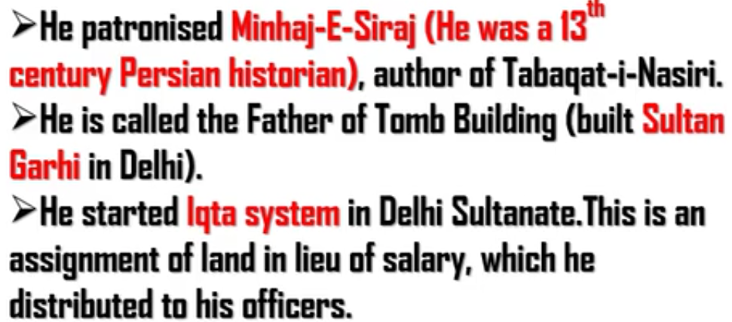
He - Iltutmish
Sultan Ghari
It is the first Islamic tomb
It was built by Iltutmish for the prince Nasirud-Din-Mahmud(son of Iltutmish)
Iqta System
Iltutmish hired officers. Instead of giving them the salary, he gave them the lands. This system came to be known as Iqta System.
The officer who took the land is known as “Iqtedar”

Slide 4
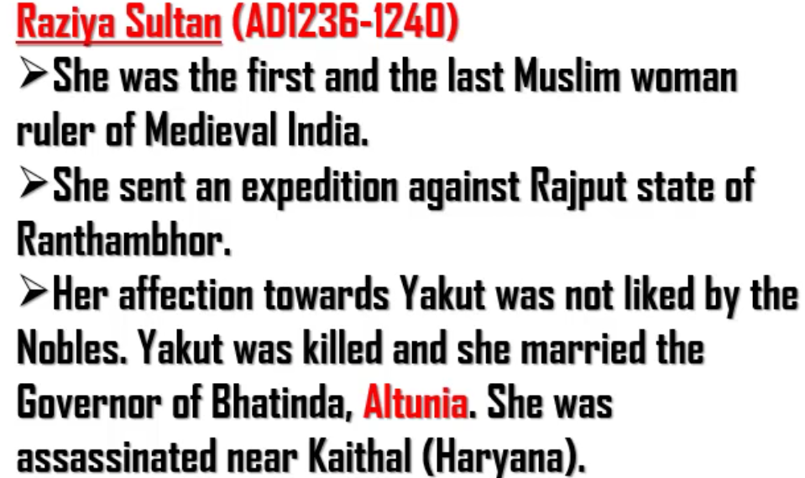
Iltutmish left the whole empire in the hands of Raziya.
Expedition – A journey made to fight a war

Slide 5
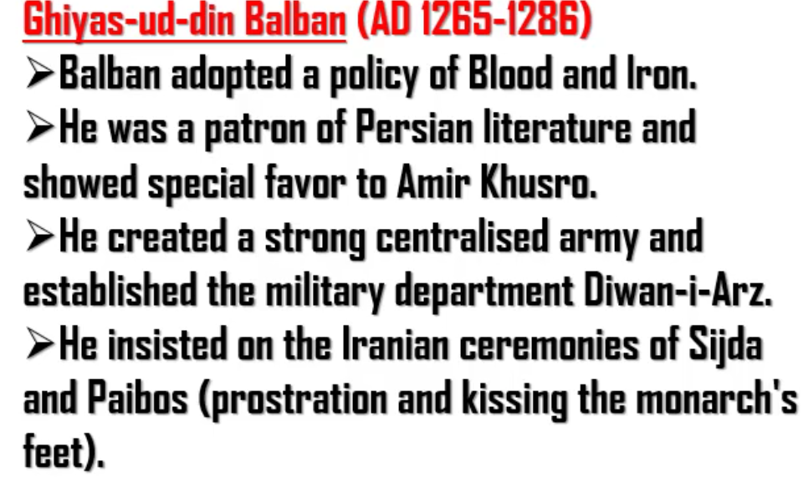
The second point means that :
Ghiyas-ud-din was follower of Persian literature.
He was mostly oriented towards famous Urdu poet Amir Khusro

Slide 6
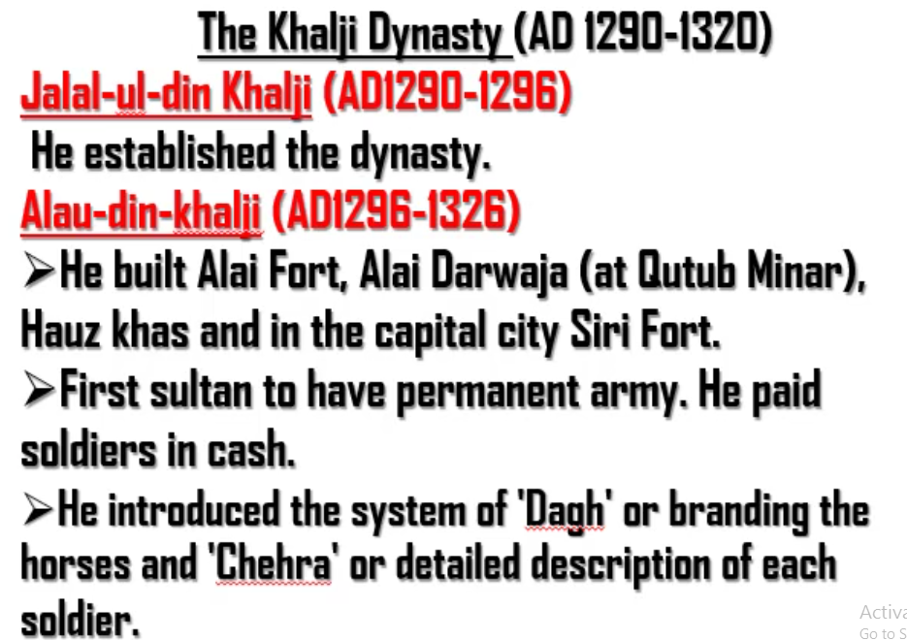
Dagh – Putting seal on horses to identify them as military horses
Chehra – It is like giving identity to each soldier. It is done to maintain security within army and to avoid intelligence (guptacharas) of enemies inside the army.

